Slide 1
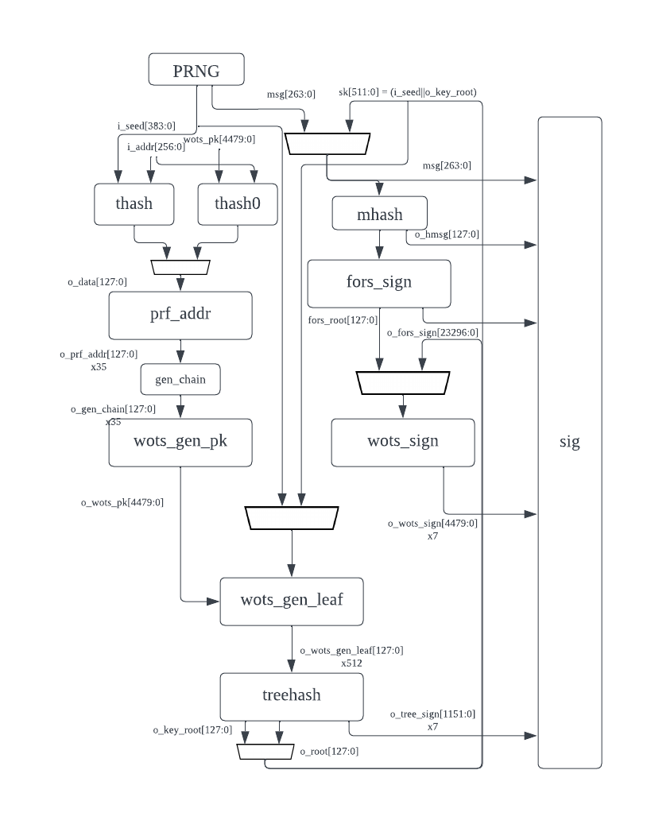
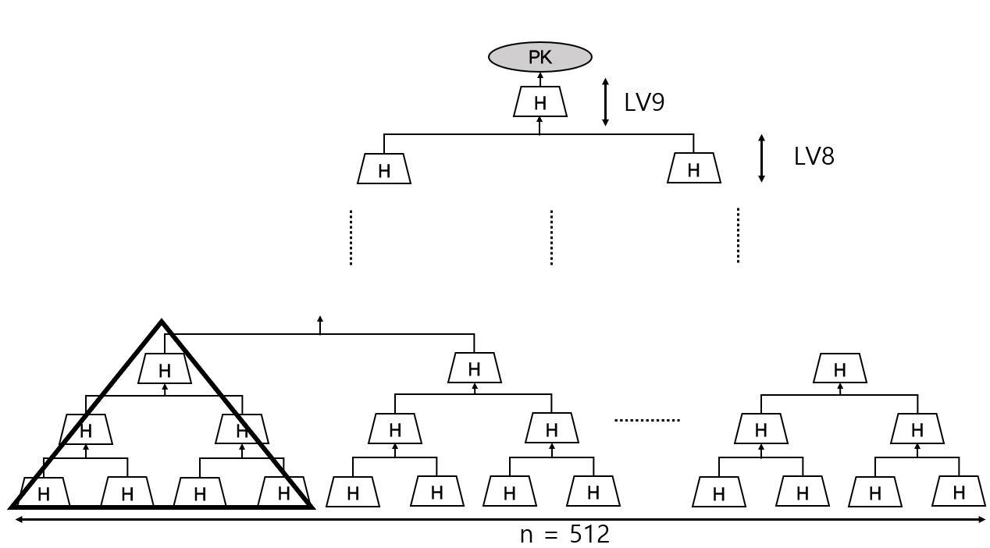
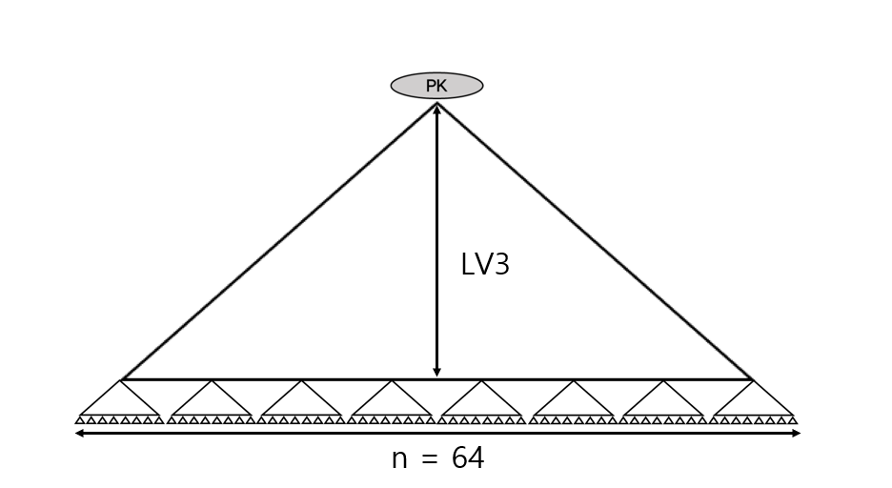
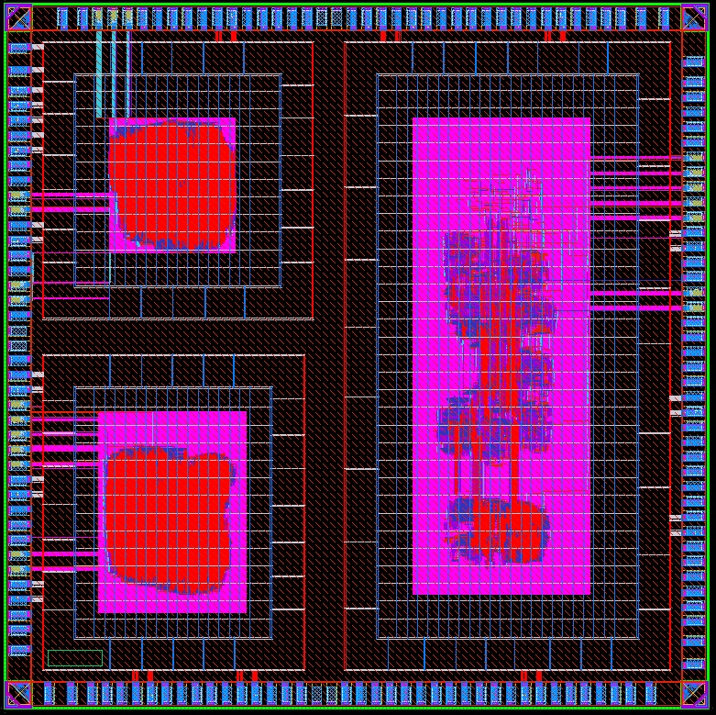
Standardized PQC(Post-Quantum Cryptography) IP
HW Implementation
Seon Bhin Kim, Jun Hui Nam and Dong Kyue Kim
Department of Electronic Engineering, Hanyang University, Seoul 133-710, Korea
Introduction
The four post-quantum cryptographic algorithms CRYSTALS-KYBER, CRYSTALS-DILITHIUM, FALCON, and SPHINCS+ have been adopted by the NIST standardization process. Among these, the lattice-based algorithms CRYSTALS-KYBER, CRYSTALS-DILITHIUM, and FALCON commonly use polynomial multiplication operations, which consume a significant portion of area and power. Efficient polynomial multiplication operations are crucial for the hardware implementation of post-quantum cryptography (PQC), and optimizing these operations is a key aspect of the implementation.
Unlike the aforementioned lattice-based algorithms, SPHINCS+ operates using hash-based computations. Although it has the disadvantages of large signature sizes and slower speeds, hash-based digital signatures have been thoroughly verified to be secure against numerous attacks. The targeted SPHINCS+ implementation requires 512 hash functions, which occupy the largest area in the SPHINCS+ implementation. To optimize the process, a tree hash with a width of 512 and a height of 9 is subdivided into subtrees.
Implementation
In In CRYSTALS-KYBER, CRYSTALS-DILITHIUM, and FALCON, polynomial multiplication is implemented using the Number Theoretic Transform (NTT). As shown in Fig. 1, two polynomials are transformed into the NTT domain, where pointwise multiplication is performed, followed by an inverse NTT process to output the product polynomial A×B.
a₀
+
a₀
+
a₀
a₀
+
a₀
+
a₀
a₃₁
a₃₁
a₃₂
a₆₃
a₃₂
a₆₃
-
a₆₃
a₆₄
-
a₆₃
CoefA
CoefA
mem
CoefA
a₆₄
a₆₄
a₆₄
Point_mul
Mul_AB
x Zetas[2]
a₉₅
x Zetas inv[124]
a₉₅
Polynomial A
Inverse
NTT
a₉₆
a₁₂₇
a₁₂₇
a₉₆
NTT_input
a₁₂₇
-
a₁₂₇
a₁₂₇
a₁₂₈
-
a₁₂₈
a₁₂₇
Select
NTT
a₁₂₈
a₁₂₈
+
a₁₂₈
+
a₁₂₈
Polynomial B
a₁₅₉
a₁₅₉
CoefB
a₁₆₀
a₁₉₁
a₁₆₀
x Zetas[1]
a₁₉₁
-
a₁₉₁
x Zetas inv[126]
a₁₉₂
-
a₁₉₁
a₁₉₂
a₁₉₂
a₁₉₂
EN
x Zetas[3]
a₂₂₃
x Zetas inv[125]
a₂₂₃
a₂₂₄
a₂₅₅
a₂₅₅
a₂₂₄
Fig. 1 Polynomial Multiplication Process
a₂₅₅
a₂₅₅
a₂₅₅
a₂₅₅
Fig. 2 NTT & Inverse NTT Algorithm
The structure of SPHINCS+, a hash-based signature, is shown in Fig. 3. Among its components, the treehash is composed of 512 hash functions in width and 9 in height, as illustrated in Fig. 4, and it consumes the most resources. By forming subtrees using 7 hash functions, as indicated by the triangular diagrams in Fig. 4, and repeating this process over 3 cycles, the effective width is reduced to 1/8 and the height to 1/3. This optimization results in a treehash with a width of 64 and a height of 3, as shown in Fig. 5.
Fig. 4 treehash & subtree
Fig. 5 Optimized treehash
F/F set
EN
LATCH
Gated CLK
CLK
Fig. 3 SPHINCS+ Architecture
Result and Discussion
Fig. 6 Layout of SPHINCS+, NTT and INTT
Fig. 7 Integrated Clock Gating (ICG) Cell
A malfunction occurred because the enable signals of a specific block did not activate. To reduce power consumption and area, clock gating cells were added as shown in Fig. 7. After synthesis, it was confirmed that both area and power consumption decreased. However, to minimize area and power consumption, the fanout was set too high, and it is suspected that timing violations occurred because too many gates were connected to a single cell.
When adding a clock gating cell, it's important to conduct timing verification under worst-case conditions and maintain an appropriate level of fanout.
The simulation in Figure 8 shows the waveform when all signals are outputting correctly, indicating successful polynomial multiplication.
Acknowledgement
This research was supported with MPW from IDEC
Fig. 8 simulation of polynomial multiplication at normal operation

